Slide 1
Amy T. Arden
PORTFOLIO

Slide 2
PROFESSIONAL SNAPSHOT fearless digital strategist passionate about Using DESIGN TO MAKE LIFE BETTER
Extensive experience taking complex requirements and developing scalable, human-centered solutions for public and private sector organizations.
Strong advocate for service design and successfully navigating the needs of business operations, associates, and customers.
Past projects include:
Leading UX design for greenfield application development at a Fortune 500 retailer, resulting in 40% reduction in interaction costs and estimated $8M in cost savings.
Developing service blueprints and a new digital lead capture process at another Fortune 500 retailer with a conversion rate 124.4% higher than competing variant, enabling increased sales.
Applying design thinking methodology at a federal agency to improve the user experience on a platform supporting innovative research on renewable energy (see Work Sample).

Slide 3
WORK SAMPLE

Slide 4
PROJECT BRIEF: ENTERPRISE APPLICATION
Industry: Federal Agency
Problem Overview: How can a legacy system be gradually updated while still retaining essential functionality?
Current State:
Aging and siloed applications
Focus on functionality rather than usability
Limited insight into current user needs, expectations, and sentiment

Slide 5
UX APPROACH
For this complex project I used the following approach:
Conducted heuristic reviews of key task flows within legacy systems
Identified primary user groups and developed relevant personas
Conducted usability testing on concepts and prototypes; integrated feedback into UX design
Collaborated with stakeholders to prioritize “must have” capabilities; aligned UX cadence to project roadmap
Developed high-fidelity interactive prototypes to show future-state functionality

Slide 6
PRIMARY PERSONAS
The application supports a competitive federal funding opportunities and serves internal and external users
Personas represent the unique needs of various internal users, the primary audience for this federal application

Slide 7
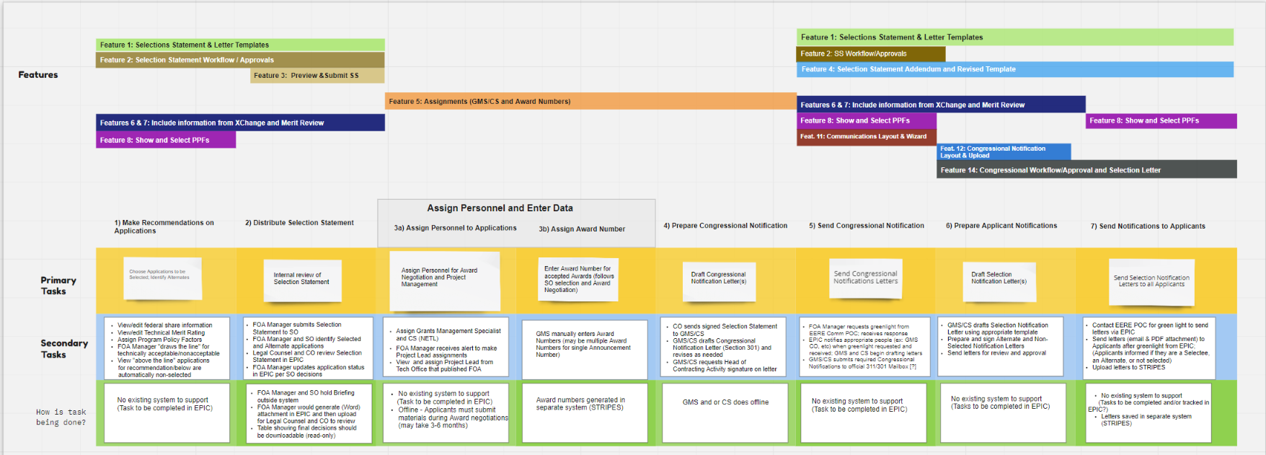
TASK HIERARCHY
Task hierarchy showing primary and secondary tasks within the intended end-to-end process, as well as how tasks are currently being accomplished
Task hierarchy also maps to application features representing must-have functionality

Slide 8
TASK HIERARCHY (DETAIL)
Detailed view of action requiring multiple substeps, and the related tasks and subtasks
Task hierarchy indicates if actions are completed within application, in a different application, or offline

Slide 9
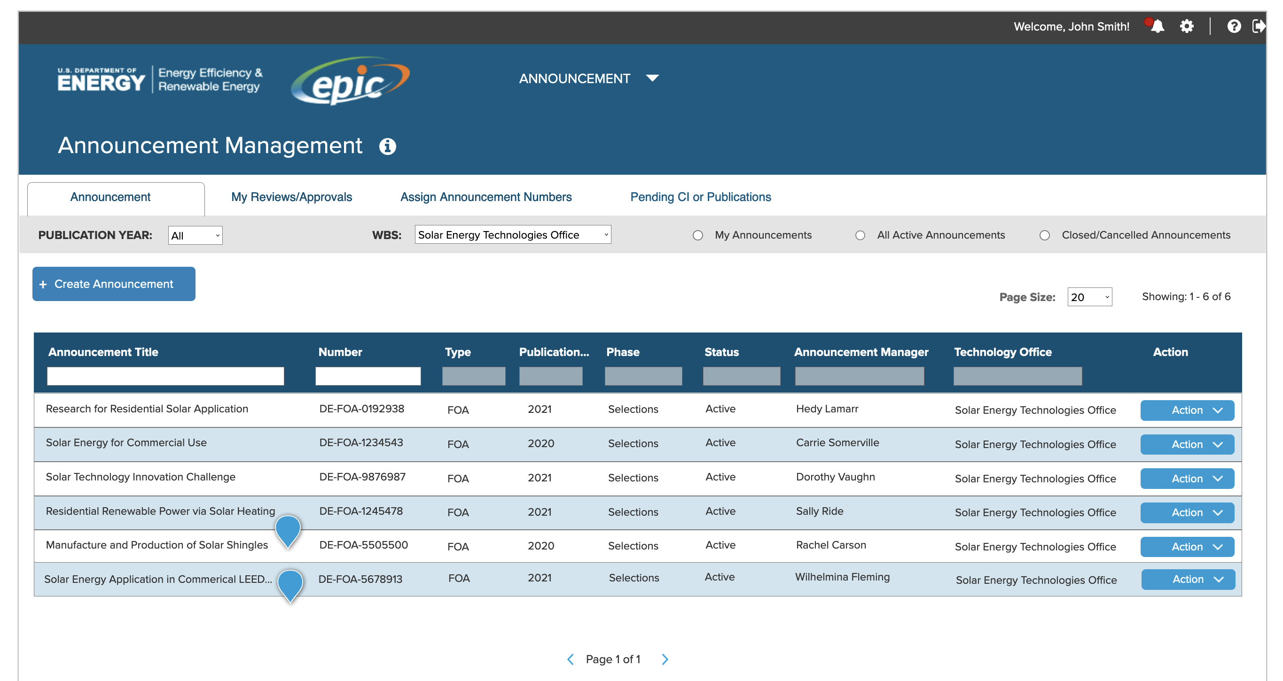
MID-FIDELITY WIREFRAME: LANDING PAGE
Page displays current funding opportunity announcements in a searchable table

Slide 10
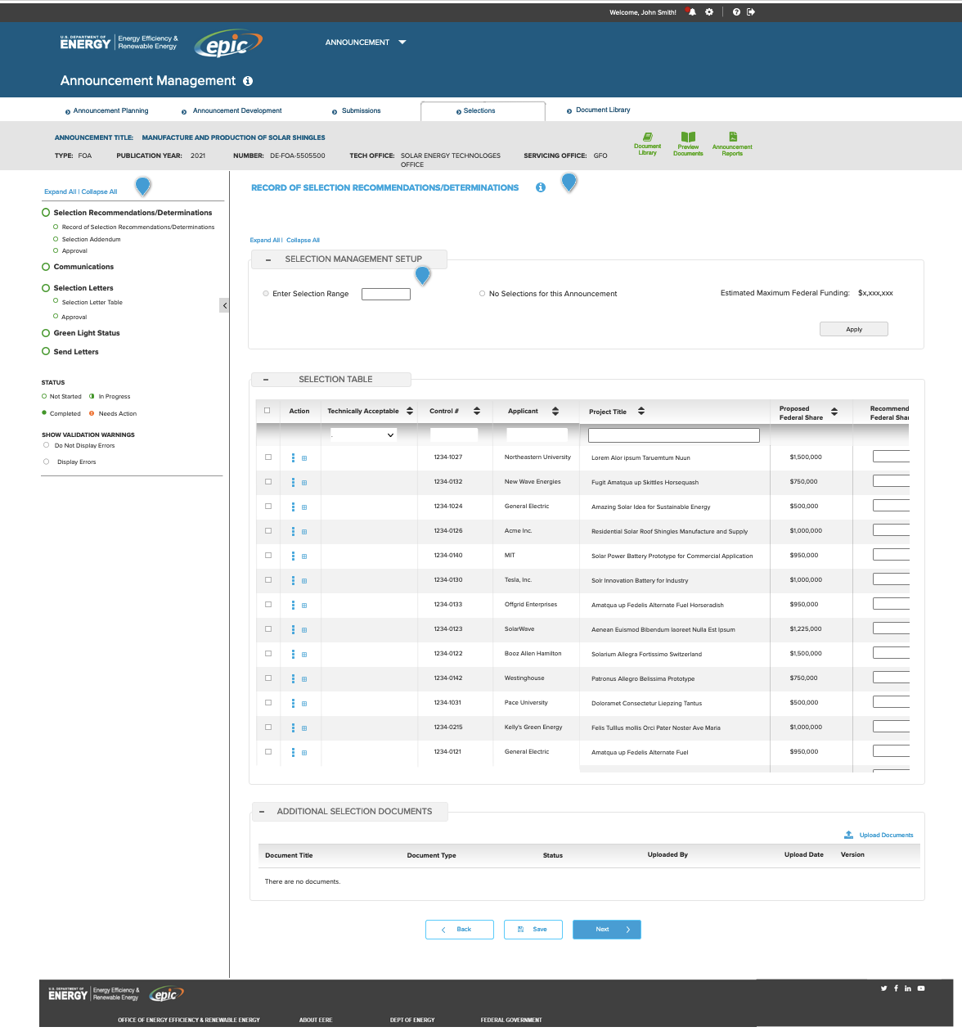
MID-FIDELITY WIREFRAME: SELECTIONS TABLE
Narrowing applications is a major task in selecting potential funding recipients
The Selections Table supports robust ways to filter and sort applications for a particular announcement

Slide 11
COLLEAGUES SAY…
“Incredibly talented and thoughtful.”
~ Todd Kelly, Director of UX Design, Dick’s Sporting Goods
“Amy is the type of person who will come to you with a problem only after she has identified at least one potential solution. She works well with clients, even difficult ones, and comes with her A-game to any initiative she is involved with.”
~ Kevin McDermott, Content Strategy Lead, Booz Allen Hamilton
“Amy was one of those people you kept hearing about; clients loved her and there was always an incredibly positive ‘buzz’ around her and her work.”
~ Jeff Pass, Digital Strategist, Booz Allen Hamilton

